Slide 1
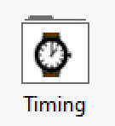
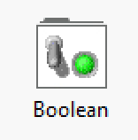
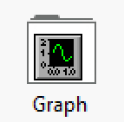
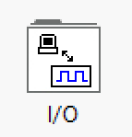
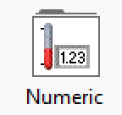
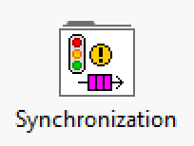
Welcome Interns!!
Please sit down according to your groups!
Andrew Oriti
George Adamopoulos
Kevin Zhou
Ty Rangnow
Anthony Detweiler
Sarah Grubber
Luca Nealon
Gayatri Nunna
Christopher Oeltjen
Nam Tram
Maya Bustami
Drew Peries
Atyula Kadur
Jacob Golden
Renzo Robles
Harshita Singh
Timi Folayan
Vishwa Kumar
Nour Jama
Yash Mahimkar
Alexis Phan
Hirad Abedzadeh
Nayef Khan
Vahe Ohihoin

Slide 2
Workshop Day 3: Bring it together Software Style!
Use what you learned from training and the past workshops to make a mini game!

Slide 3
Agenda
Today you will be challenged to put your LabVIEW skills to the test and make a miniature mini game!
1
2
3
Local Variables
Talk about local variables
Edit the template!
Use a template to make a mini game!
Check out a different implementation
Daniel will show a creative example!

Slide 4
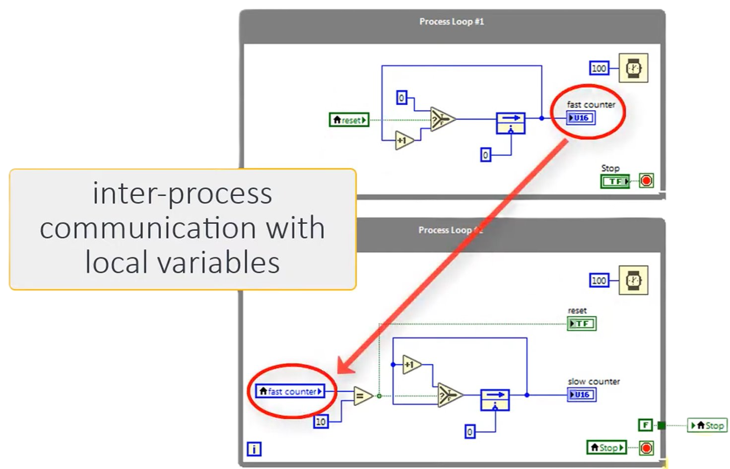
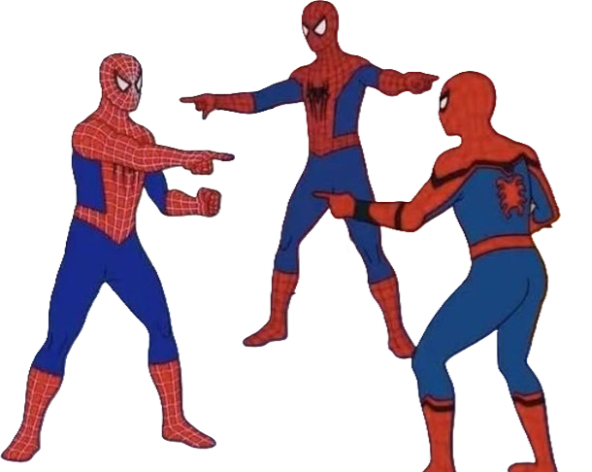
Local Variables
Local Variables are instances of a variable that can be written or read from multiple places and affect each other and the original!

Slide 5
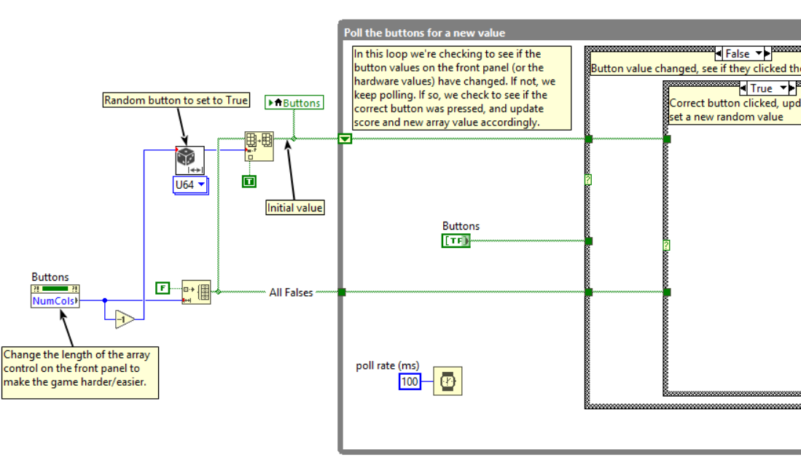

Build a Mini Game
Look at Provided Guide for instructions!

Slide 6
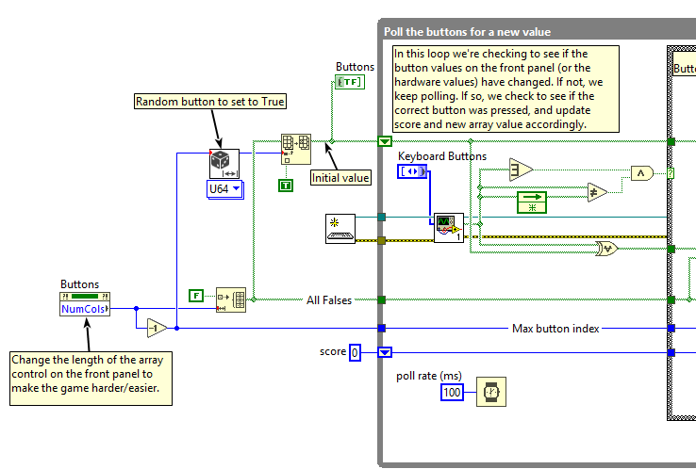
Look at this Implementation
Daniel created a cool implementation to look at!

Slide 7
Discussion Time!
Did the template help? Was it harder to think through?

